Slide 1

Machine Learning
Ajay Rawat, SAP
Month 10, 2018

Slide 2
Agenda
Day 1:Linear and Logistic Regression
Introduction To Machine Learning
Linear and Polynomial Regression
Logistic Regression
Bias and Variance
Day3:Kaggle Titanic Machine Learning Challenge:
Exploratory Data Analysis and Data Pre-Processing
Classification Metrics: Precision and Recall
Predictions using Random Forest
Day2: Tree Based algorithms and SVM
Decision Trees
Random Forest
Gradient Boosted Trees
Support Vector Machines
Day4: Advanced Techniques
Feature Engineering
K-Fold Cross Validation
Hyperparameter Tuning
Model ensemble

Slide 3
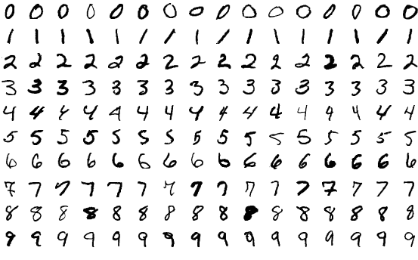
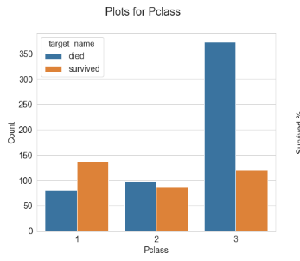
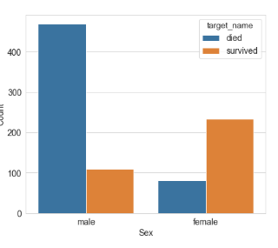
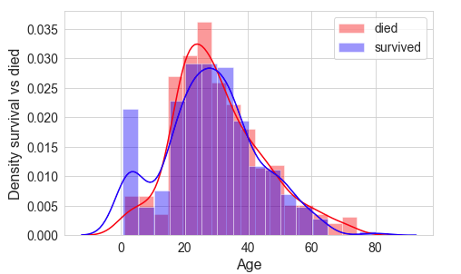
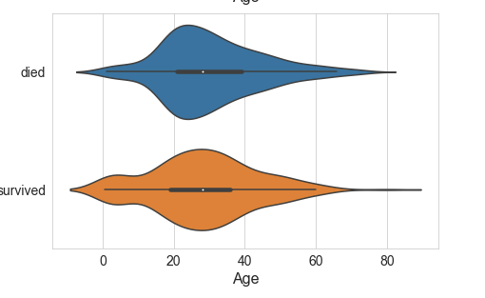
Sample Problems in this Training
Can we predict college GPA of students based on High school GPA?
Can we teach computers to recognize handwritten digits
Can we predict who survived in Titanic Disaster and analyze what factors contributed to survival or death of passengers

Slide 4
Machine Learning
By definition, Machine learning provides computers with the ability to learn without being explicitly programmed.
Machine learning explores the study and construction of algorithms that can learn from and make predictions on data
Lets try to understand it using a simple drawing game developed by Google to teach a computer to identify drawing made my humans
https://quickdraw.withgoogle.com/

Slide 5
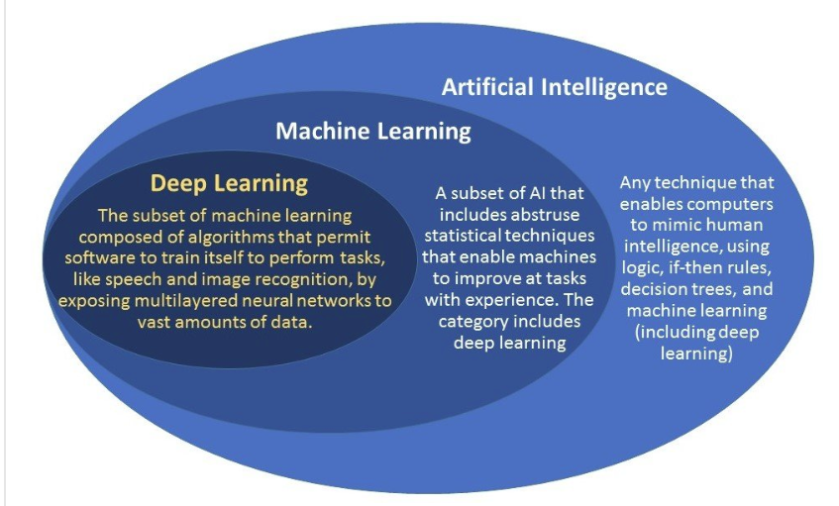
Artificial Intelligence
Artificial intelligence is any computer program that does something smart. It can be a stack of a complex statistical model or if-then statements. Examples enemies in Computer Games, IBM’s Deep Blue,
Machine learning is a subset of AI. The theory is simple, machines take data and ‘learn’ for themselves. It is currently the most promising tool in the AI pool for businesses. Example: Prediction house prices or predict which customers will default on loan
Deep learning is a subset of machine learning. Deep artificial neural networks are a set of algorithms reaching new levels of accuracy for many important problems, such as image recognition, sound recognition, recommender systems, etc..

Slide 6
Machine Learning Use Cases: Examples from Kaggle competition
Analyze a Google Merchandise Store customer dataset to predict revenue per customer using online logs from Google Analytics data ga-customer-revenue-prediction
Build a model that predicts the probability that a driver will initiate an auto insurance claim in the next year. safe-driver-prediction
Predict repayment abilities for clients with insufficient or non-existent crédit histories. home-credit-default-risk
Build a model that detects all ships in satellite images as quickly as possible. Shipping traffic is growing fast. More ships increase the chances of infractions at sea like environmentally devastating ship accidents, piracy, illegal fishing, drug trafficking, and illegal cargo movement. airbus-ship-detection
Using News to Predict Stock Movements: two-sigma-financial-news

Slide 7
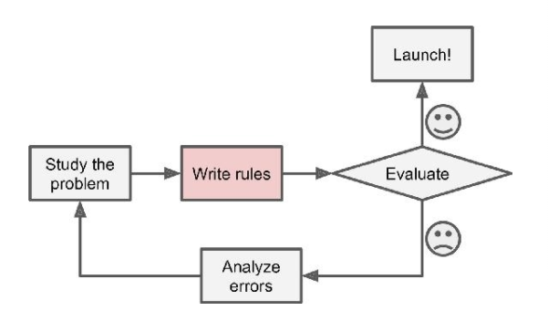
Traditional Programing
Spam Filter Using Traditional Programming
Use common spam words(‘Amazing’, ‘offer’, ‘credit card’), to classify if a email is spam
Write rules to incorporate the spam word in Logic.
If a new word (“Great” instead of “Amazing’) is used by spammers, write new rules

Slide 8
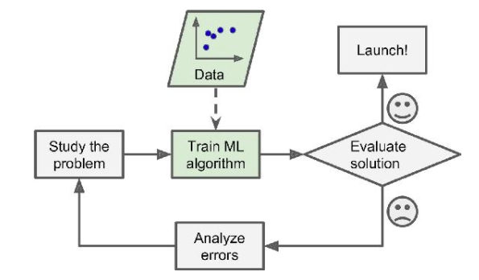
Machine Learning
Spam Filter Using Machine Learning
Use Flag if a email is spam and ML Algorithm learns what words spam email contain
If a new word (“Great” instead of “Amazing’) is used by spammers, users will flag it as spam and ML algorithm automatically detects the pattern.

Slide 9
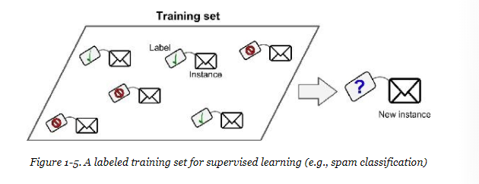
Supervised Learning: Classification
Classification: Classify is a mail is spam or not
When we want predict discrete values which are independent.
Predicted if a email is spam or not
Predict the species of flower
Predict objects in Images

Slide 10
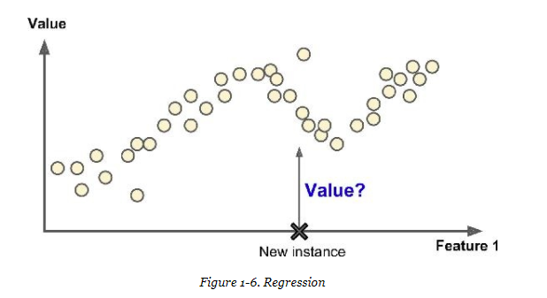
Supervised Learning: Regression
Regression: When we want to predict continuous values
Predict house prices based on the location and house properties
Forecast the revenue of a retail store
Forecast energy demand for an utilities company

Slide 11
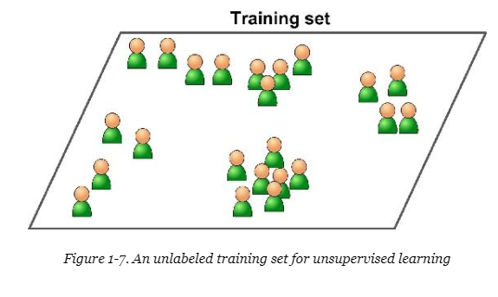
Unsupervised Learning
Learning without teacher, there is no labelled data
Clustering: A clustering problem is where you want to discover the inherent groupings in the data, such as grouping customers by purchasing behavior.
Association: An association rule learning problem is where you want to discover rules that describe large portions of your data, such as people that buy X also tend to buy Y.

Slide 12
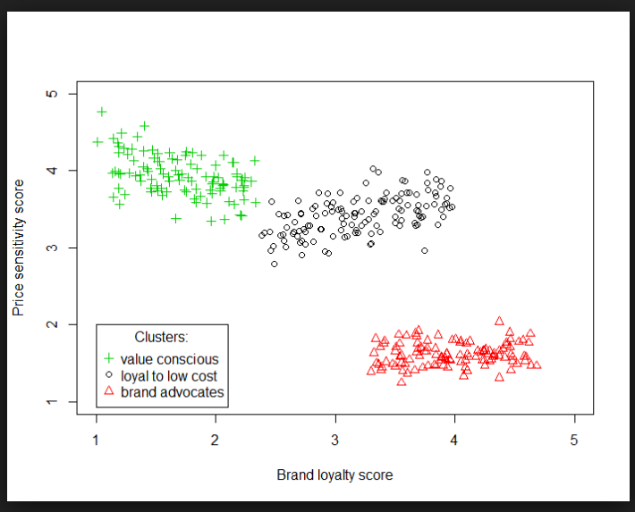
Unsupervised Learning Examples: Clustering
A marketing team can target different segments of customer based on loyalty and price sensitive

Slide 13
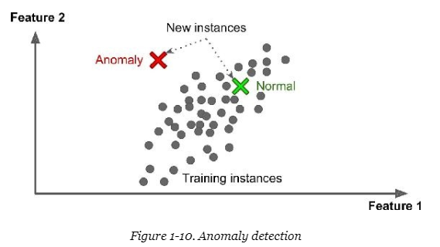
Unsupervised Learning Examples Anomaly Detection
A financial institution can detect fraud using anomaly detection

Slide 14
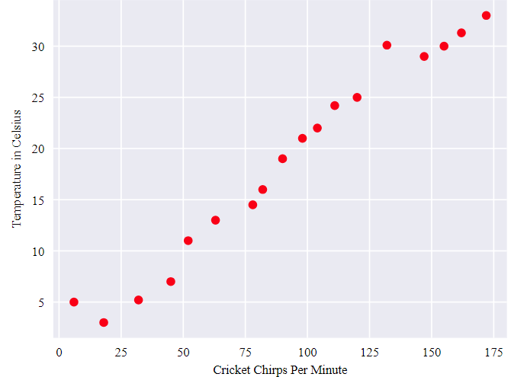
Linear Regression
Crickets (an insect species) chirp more frequently on hotter days than on cooler days
The plot shows the temperature rising with the number of chirps.
Is this relationship between chirps and temperature linear?
Can we predict the temperature based on number of cricket chirps per minute
https://developers.google.com/machine-learning/crash-course/descending-into-ml/linear-regression

Slide 15
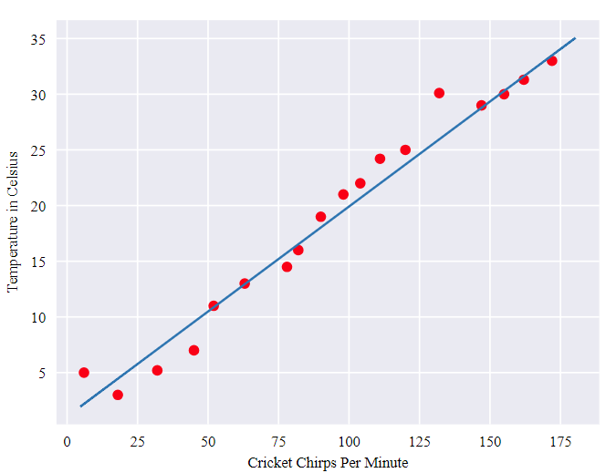
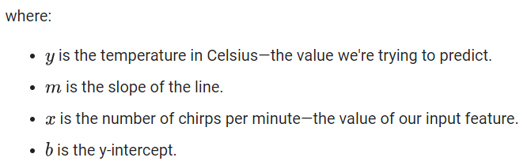
Linear Regression
We could draw a single straight line like the following to approximate this relationship:
Using the equation for a line, you could write down this relationship as : y = mx + b

Slide 16
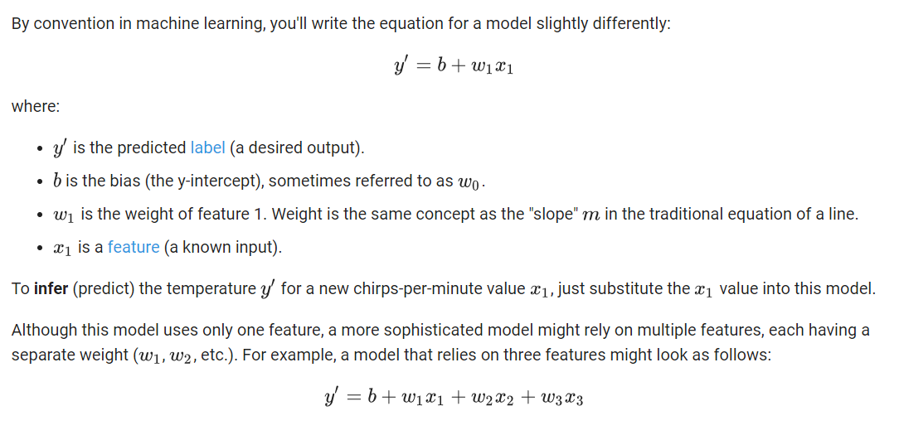
Linear Regression

Slide 17
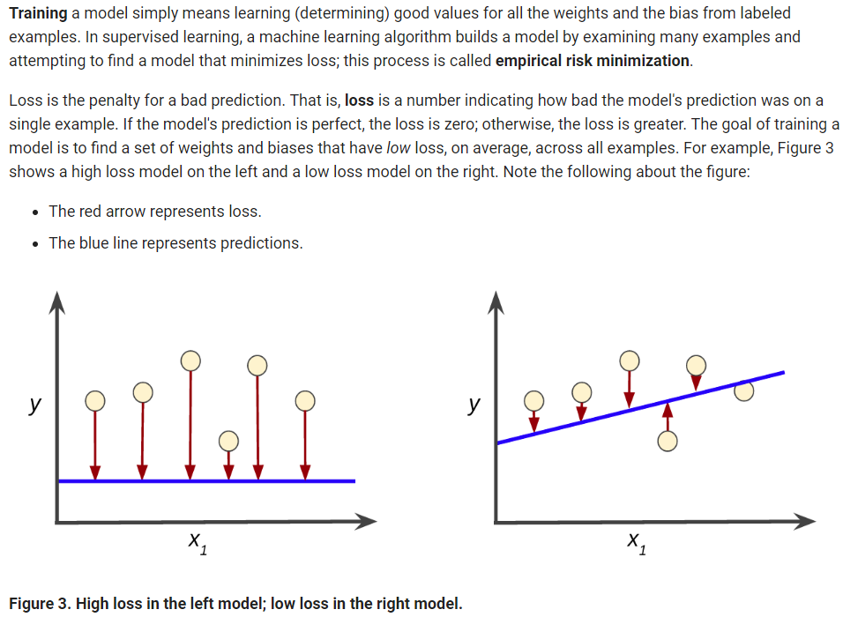
Linear Regression: Training and Loss

Slide 18
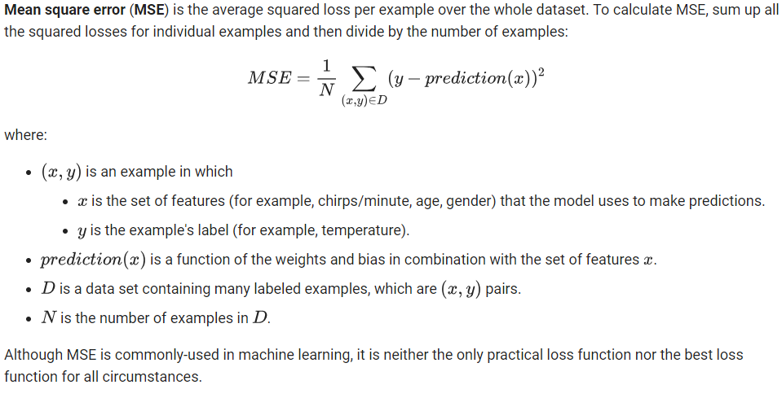
Linear Regression: Training and Loss

Slide 19
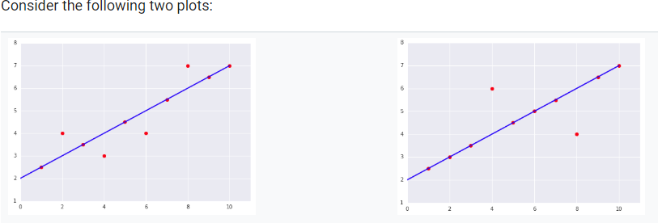
Linear Regression: Check Your Understanding

Slide 20
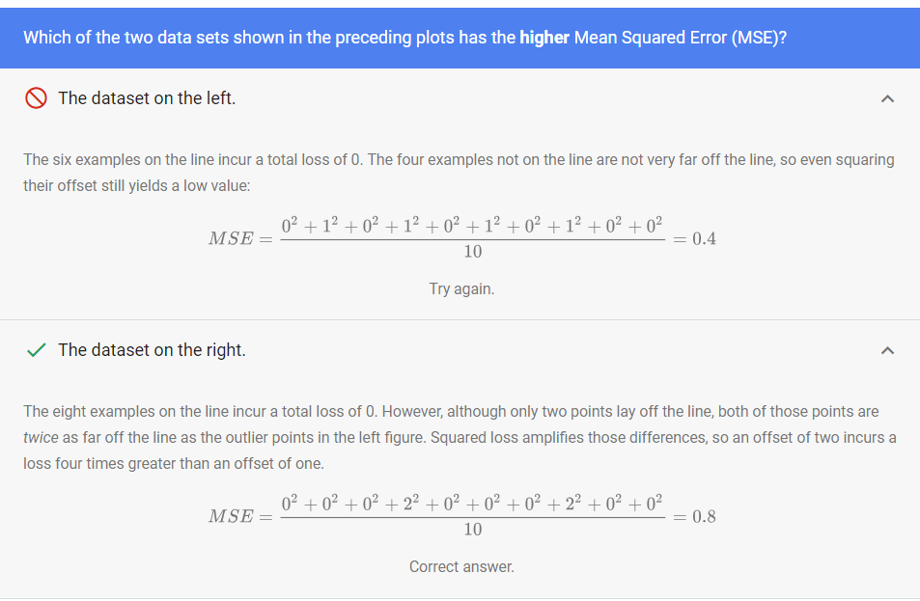
Linear Regression: Check Your Understanding

Slide 21
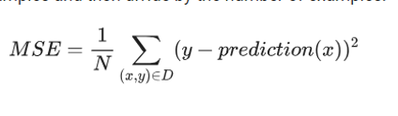
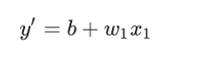
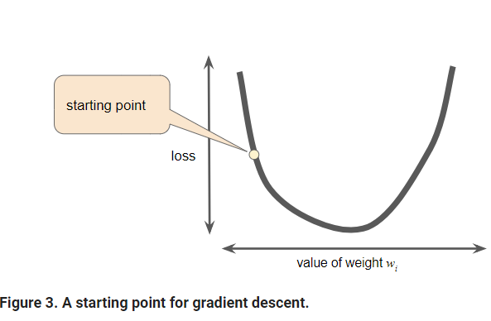
Linear Regression: Reducing Loss: Gradient Descent

Slide 22
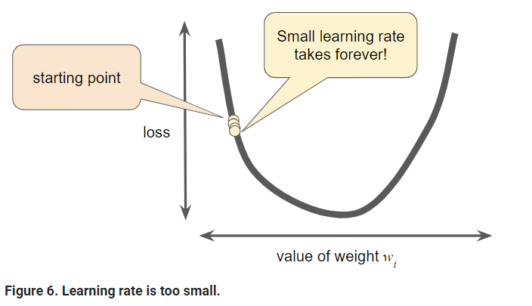
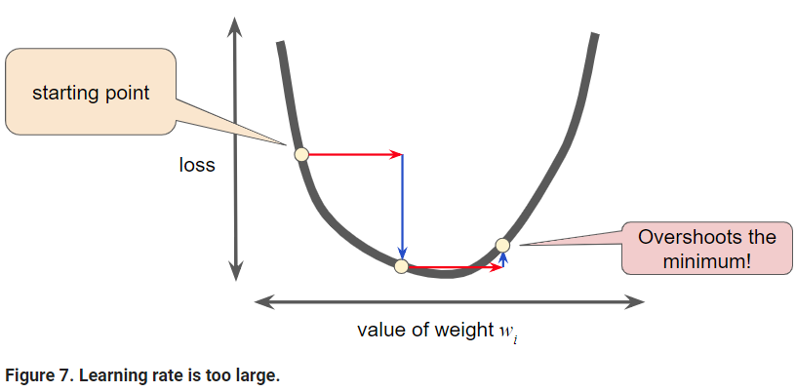
Gradient Descent: Learning Rate

Slide 23
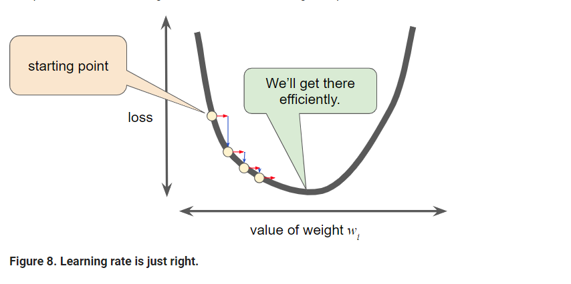
Gradient Descent: Learning Rate

Slide 24
Optimizing Learning Rate
Experiment with different learning rates and see how they affect the number of steps required to reach the minimum of the loss curve
https://developers.google.com/machine-learning/crash-course/fitter/graph

Slide 25
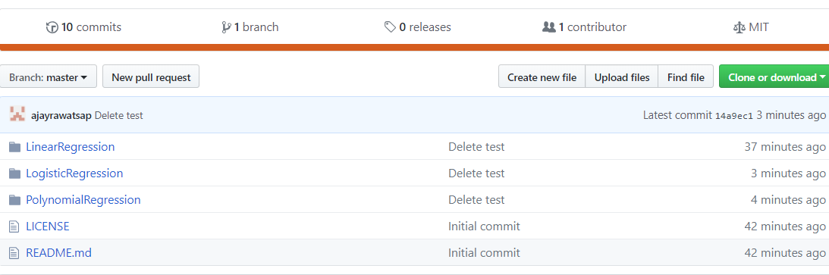
Linear Regression Exercise
Download the project from GitHub account https://github.com/ajayrawatsap/MLTraining
Go to folder LinearRegression and open the Solution and Exercise files from Jupyter Notebooks
You can follow me for exercises or run the individual cells in solution notebook

Slide 26
Linear Regression Pros And Cons
Pros
Simple to understand and less HyperParameters to tune
Is efficient in memory and computational requirements
Linear Regression provides a good way to study more than one variables
Cons
Linear Regression Is Limited to Linear Relationships
Linear Regression Is Sensitive to Outliers
Data Must Be Independent

Slide 27
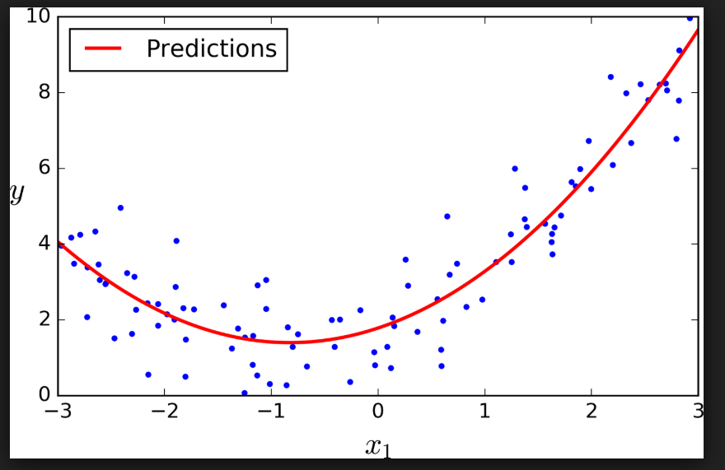
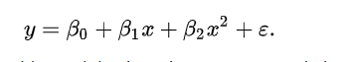
Polynomial Regression
In many settings, linear relationship may not hold.
For example, if we are modeling the yield of a chemical synthesis in terms of the temperature at which the synthesis takes place,
In this case, we might propose a quadratic model of the form
A Polynomial Regression is a form of Linear Regression where equation can be represented by

Slide 28
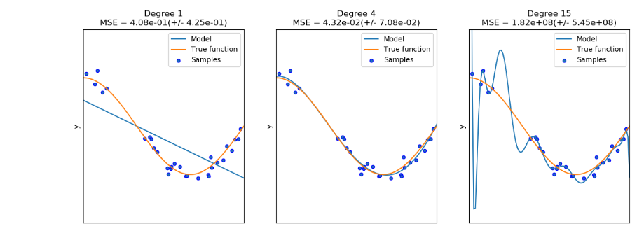
Polynomial Regression: Overfitting and Underfitting
We can see that a linear function (polynomial with degree 1) is not sufficient to fit the training samples. This is called underfitting.
A polynomial of degree 4 approximates the true function almost perfectly.
However, for higher degrees the model will overfit the training data, i.e. it learns the noise of the training data.

Slide 29
Polynomial Regression Exercise
Download the project from GitHub account https://github.com/ajayrawatsap/MLTraining.
Go to folder PolynomialRegression and open the Solution and Exercise files from Jupyter Notebooks
You can follow me for exercises or run the individual cells in solution notebook

Slide 30
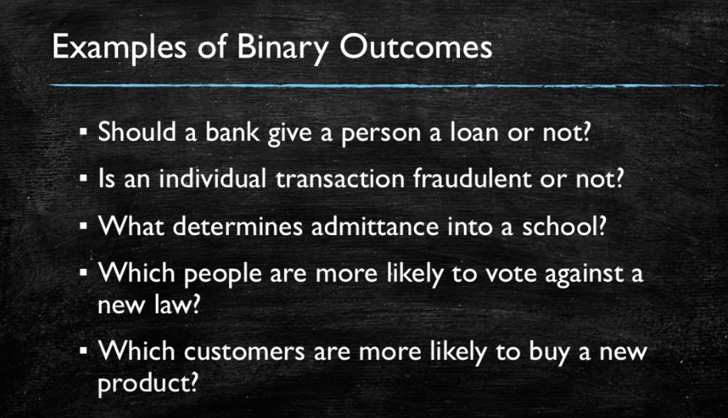
Logistic Regression: Binary Outcomes youtube link

Slide 31
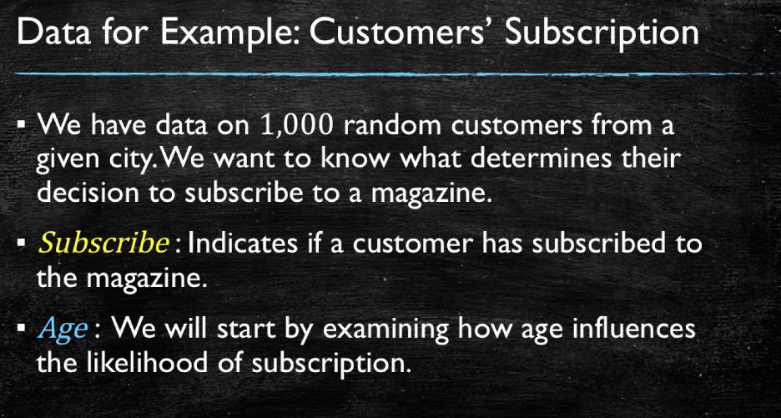
Logistic Regression: Classification Example

Slide 32
Logistic Regression: Classification Example

Slide 33
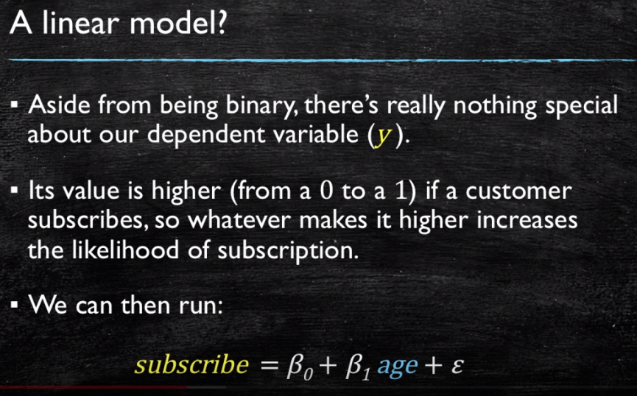
Logistic Regression: Can we use Linear Model?

Slide 34
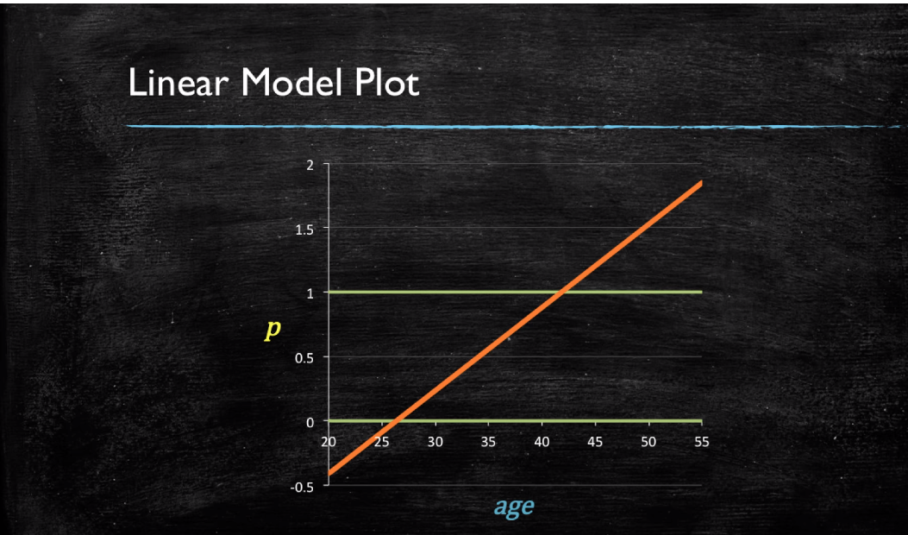
Logistic Regression: Problems with Linear Model

Slide 35
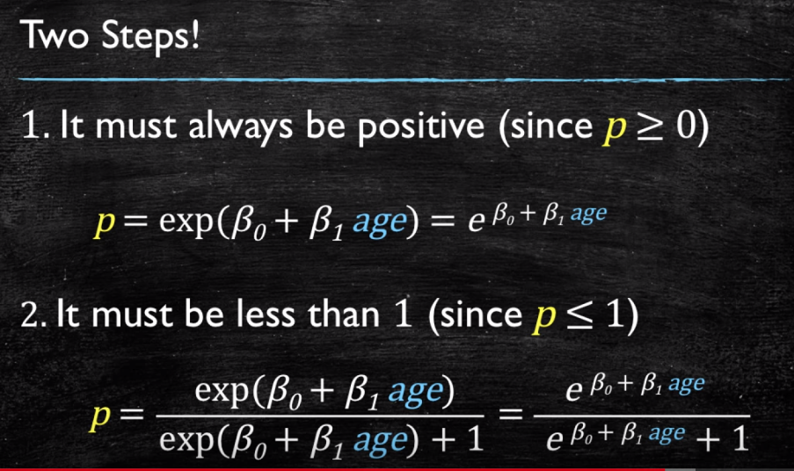
Logistic Regression: Fixing The previous approach

Slide 36
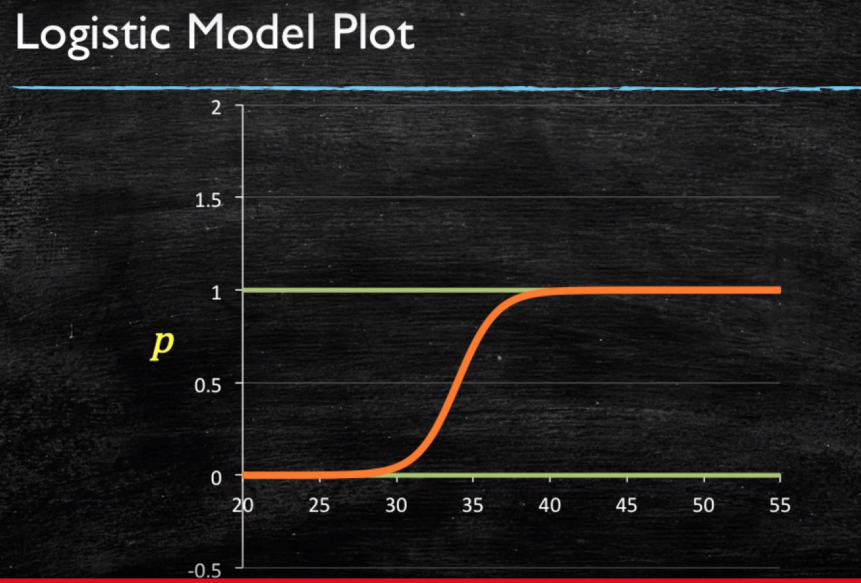
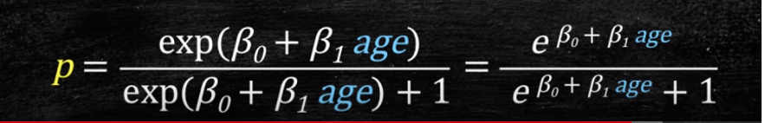
Logistic Regression: The Logistic Model

Slide 37
Logistic Regression Exercise
Download the project from GitHub account https://github.com/ajayrawatsap/MLTraining
Go to folder LogisticRegression and open the Solution and Exercise files from Jupyter Notebooks
You can follow me for exercises or run the individual cells in solution notebook

Slide 38
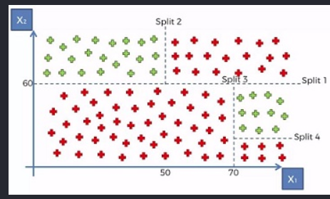
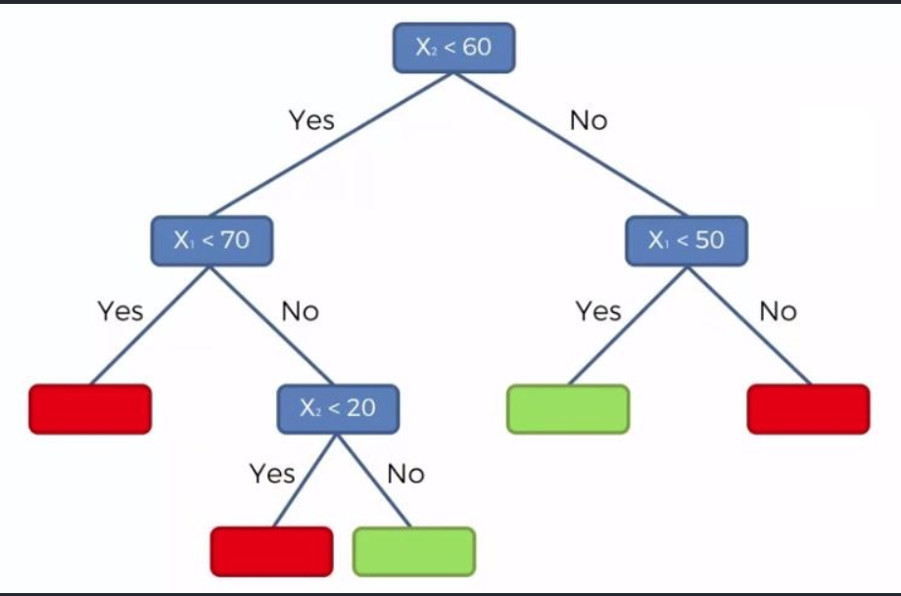
Decision Tree Classification

Slide 39
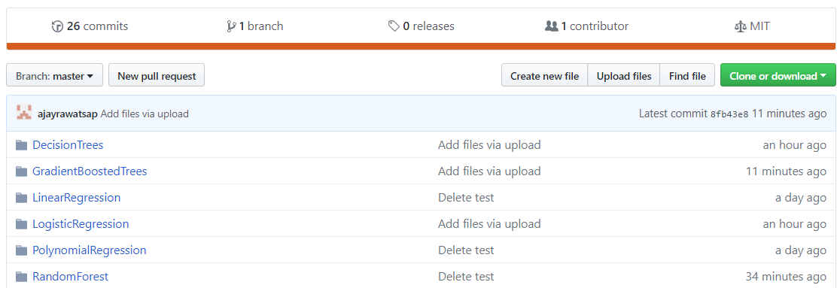
Decision Tree Exercise
Download the project from GitHub account https://github.com/ajayrawatsap/MLTraining
Go to folder DecisonTrees and open the Solution and Exercise files from Jupyter Notebooks
You can follow me for exercises or run the individual cells in solution notebook

Slide 40
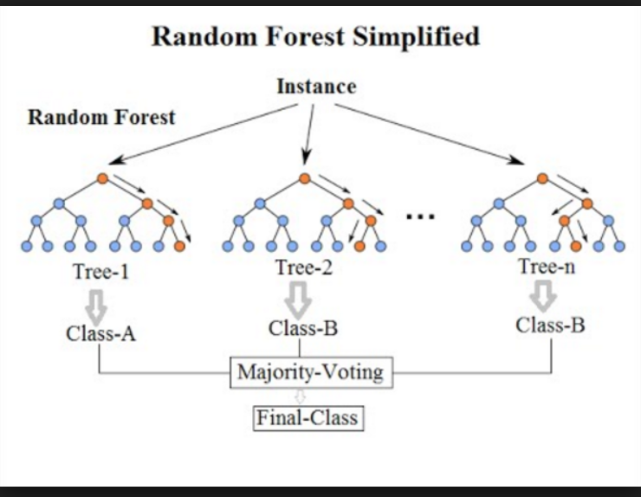
Random Forest Classification

Slide 41
Random Forest Classification
Random Forest creates diverse trees by using random subset of features and rows for each decision tree.
Each tree is trained on different features and dataset (Using Bootstrap sampling).
The final predications is based on collective predication so that predictions from majority of decision trees are taken into account.
The collective prediction can be better than the most accurate prediction at individual level. Reason why it works can be shown below
Suppose there are 5 samples on which prediction made by 3 decision trees. We get accuracy of 80% when combining predictions, even though individual tree has maximum accuracy of 60%. Since the trees are diverse they make different mistakes. But if all trees were similar we will not get better accuracy for combined predictions

Slide 42
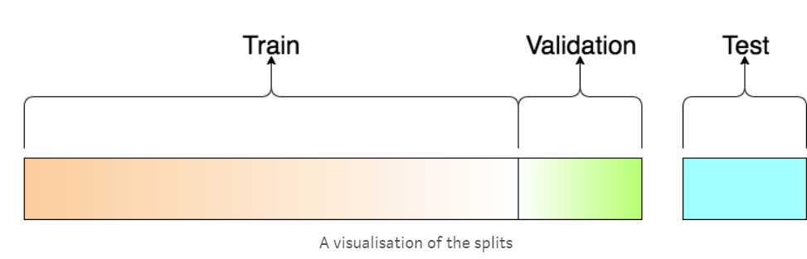
Train, Validation and Test Sets in Machine Learning
Training Dataset: The sample of data used to fit the model.
The actual dataset that we use to train the model The model sees and learns from this data.
Validation Dataset: The sample of data used to provide an unbiased evaluation of a model fit on the training dataset while tuning model hyperparameters. The evaluation becomes more biased as skill on the validation dataset is incorporated into the model configuration.
Test Dataset: The sample of data used to provide an unbiased evaluation of a final model fit on the training dataset.
The Test dataset provides the gold standard used to evaluate the model. It is only used once a model is completely trained(using the train and validation sets).

Slide 43
Random Forest Exercise
Download the project from GitHub account https://github.com/ajayrawatsap/MLTraining
Go to folder RandomForest and open the Solution and Exercise files from Jupyter Notebooks
You can follow me for exercises or run the individual cells in solution notebook

Slide 44
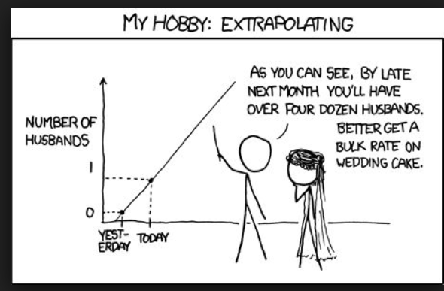
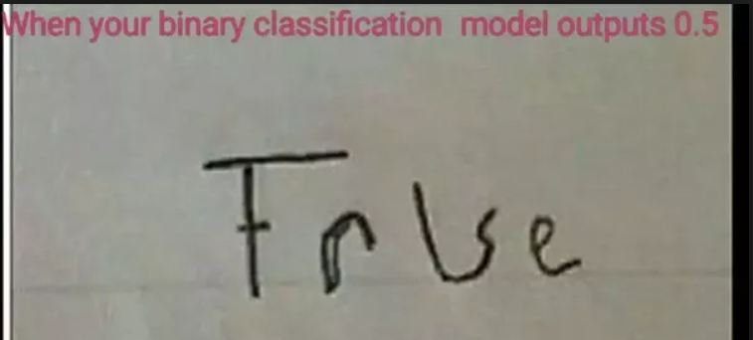
Machine Learning Humor:
Outlier = Out You Lair !
Data is like people – interrogate it hard enough and it will tell you whatever you want to hear.
What do you call a group of variables that go to Gym? A training set

Slide 45
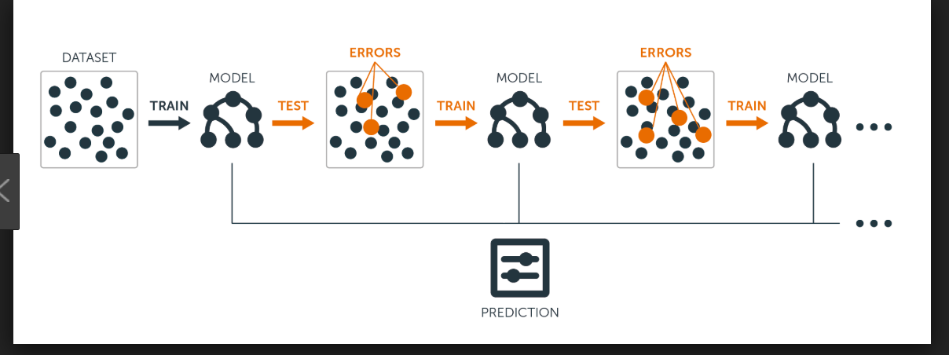
Gradient Boosted Trees
Random Forest and Gradient boosted trees use decision trees as base learners. Where as Randomforest train all trees in parallel, the Gradient boosted trees does it sequentially
We first model data with simple models and analyze data for errors.
These errors signify data points that are difficult to fit by a simple model.
Then for later models, we particularly focus on those hard to fit data to get them right.
In the end, we combine all the predictors by giving some weights to each predictor

Slide 46
Gradient Boosted Trees
Download the project from GitHub account https://github.com/ajayrawatsap/MLTraining
Go to folder GradientBoostedTrees and open the Solution and Exercise files from Jupyter Notebooks
You can follow me for exercises or run the individual cells in solution notebook

Slide 47
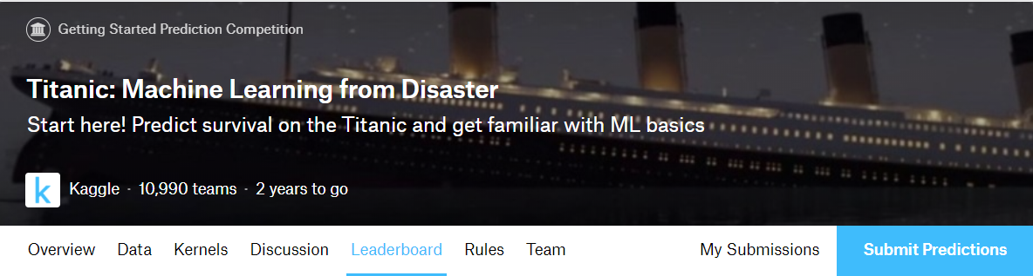
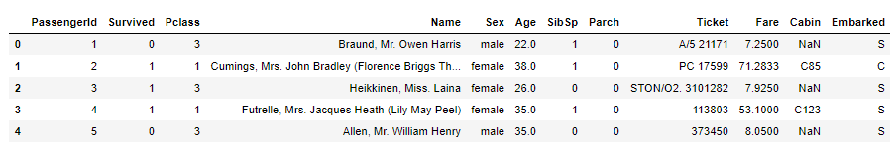
Kaggle Titanic Machine Learning Challenge:
https://www.kaggle.com/competitions

Slide 48
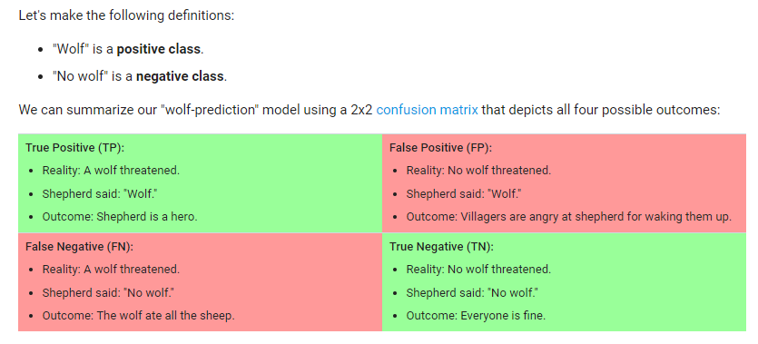
Classification: Confusion Matrix
A true positive is an outcome where the model correctly predicts the positive class.
A true negative is an outcome where the model correctly predicts the negative class.
A false positive is an outcome where the model incorrectly predicts the positive class.
A false negative is an outcome where the model incorrectly predicts the negative class

Slide 49
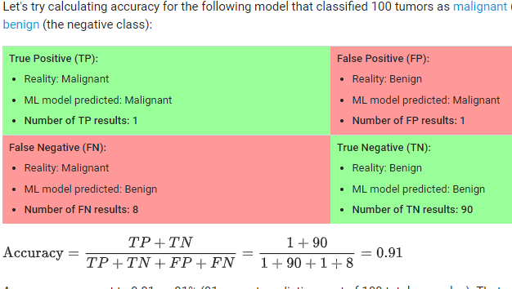

Classification: Accuracy
0.91 Accuracy seems to be great but?
Of the 100 tumor examples, 91 are benign (90 TNs and 1 FP) and 9 are malignant (1 TP and 8 FNs).
Of the 91 benign tumors, the model correctly identifies 90 as benign. That's good. However, of the 9 malignant tumors, the model only correctly identifies 1 as malignant—a terrible outcome, as 8 out of 9 malignancies go undiagnosed
A tumor-classifier model that always predicts benign would achieve the exact same accuracy (91/100 correct predictions)
Accuracy alone doesn't tell the full story when you're working with a class-imbalanced data set, like this

Slide 50


Classification: Precision and Recall
Precision attempts to answer the following question: What proportion of positive identifications was actually correct?
Recall attempts to answer the following question: What proportion of actual positives was identified correctly?

Slide 51


Precision and Recall : Which Metric to choose
Example 1: A medical company is doing diagnosis for cancer and building predictive model.
0: Patient do not have cancer
1: Patient has cancer
Since more than 99% of people who undergo such test will belong to class 0, we cannot rely on accuracy score. A patient who has cancer but is predicted by model as not having cancer(False Negative) is a serious medical lapse which needs to be minimized. Recall is suitable metric here as it has FN in denominator and aims to minimize the same
Example 2: A video search engine is deploying a predictive model to classify a video safe for children
0: Video is not safe
1: Video is safe
Majority of videos are safe so in such cases its important that our model accurately detects unsafe videos belonging to class 0. A video which is unsafe but marked as safe (False Positive) can have serious business consequences hence Precision should be used as metric which aims to minimize False Positives.

Slide 52


Slide 53


Slide 54


Slide 55



Slide 56


Slide 57

Thank you.

Slide 58


Slide 59

https://www.udemy.com/machinelearning/learn/v4/t/lecture/6760386?start=0

Slide 60


Slide 61


Slide 62

Neural Networks
NN Playground

Slide 63


Natural Language Processing: Text Classification
Step 1 Clean Text using NLP toolkit
Restaurant Review
Review | Liked
Wow ….this is Lovely food ? | 1
wow good food…. | 1
bad food !!!! | 0
Review
wow love food
wow good food
bad food
Step 2 Create Bag of word Model
Step 3 Train The model
Step 4 Predict
Review | Liked
wow amazing food | 1

Slide 64

Neural Networks Image Recognition

Slide 65
Resources and Links
Quora Page for ML Learning Path
Book- ML using Python Scikit-Learn and Tensorflow
Book-ML Fundamentals
Book- Deep Learning using Keras
Course-Machine Learning Udemy
Course-Machine Learning- Coursera
Course-Deep Learning-Coursera
E-book: Deep Learning Fundamentals
SAP YouTube Channel for ML on Hana

